Slide 1






A new generation
of tech specialists

Slide 2
Predicting Poverty Level Using World Bank Indicators
Team Members:
Sultan Mansour Raofi
Arezo Mohammadi
Ahmad Shabir Khairzad

Slide 3
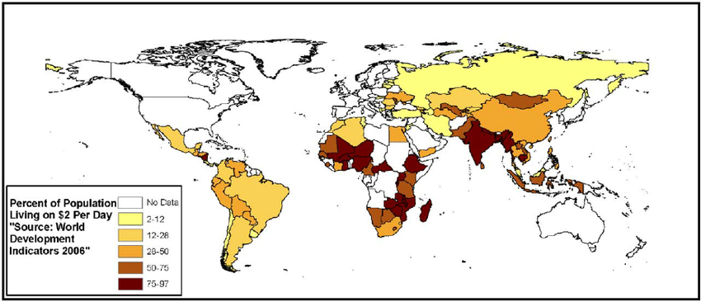
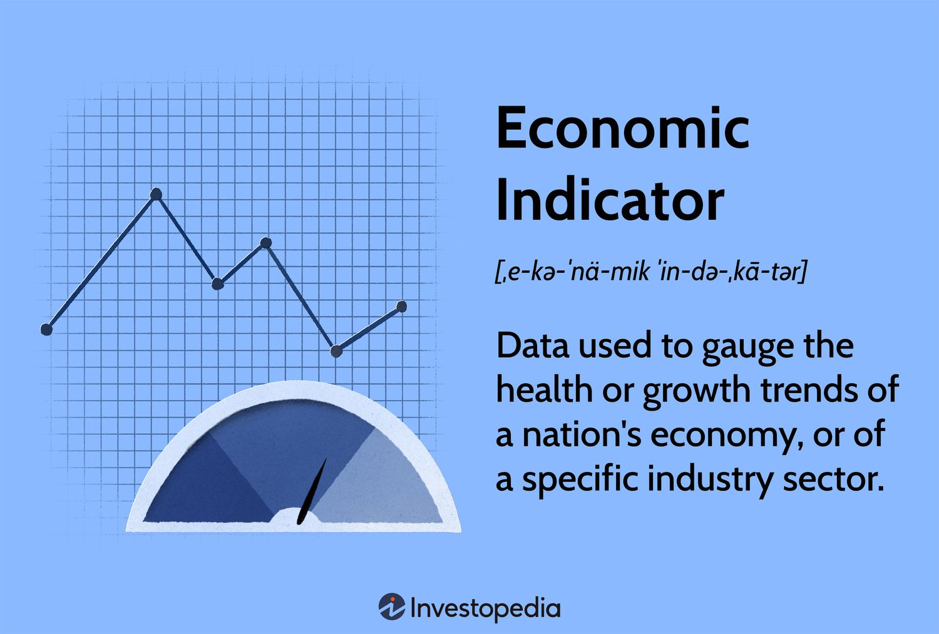
Outline
Concept Note and Implementation Plan:
Background & Objectives
SDG Relation & Data
Exploratory Data Analysis (EDA) and Feature Engineering
Model Selection, Training & Model Evaluation and Hyperparameter Tuning
Model Refinement and Hyperparameter Tuning
Results, Deployment & Future Work

Slide 4
Background
Project Overview:
Addresses the challenge of outdated/incomplete poverty data by leveraging the World Bank Development Indicators (WDI).
Uses machine learning models to predict poverty levels and assist policymakers in targeted resource allocation.
Importance of the Problem:
Reliable, up-to-date poverty predictions help guide interventions and drive socioeconomic development.
Brief Background:
Traditional methods suffer from delays and inefficiencies.
Our approach employs modern ML techniques to analyze diverse socioeconomic data.

Slide 5
Objectives
Project Objectives:
Develop and deploy a machine learning model that predicts poverty levels using selected World Bank indicators.
Analyze the correlation between socioeconomic factors (GDP, literacy, healthcare, etc.) and poverty.
Provide a robust tool for policymakers with actionable insights.
Model Goals:
Achieve high accuracy and interpretability.

Slide 6
SDG Relation
Alignment with SDG 1: No Poverty:
Directly supports efforts to reduce poverty by enabling targeted interventions based on accurate data.
Helps prioritize resource allocation in high-need areas through data-driven insights.
Impact:
Informed decision-making contributes to overall socioeconomic development and poverty alleviation.

Slide 7
Data

Slide 8
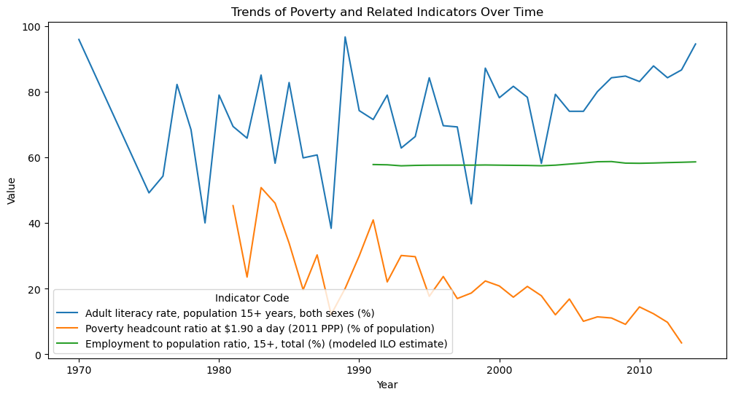

Slide 9
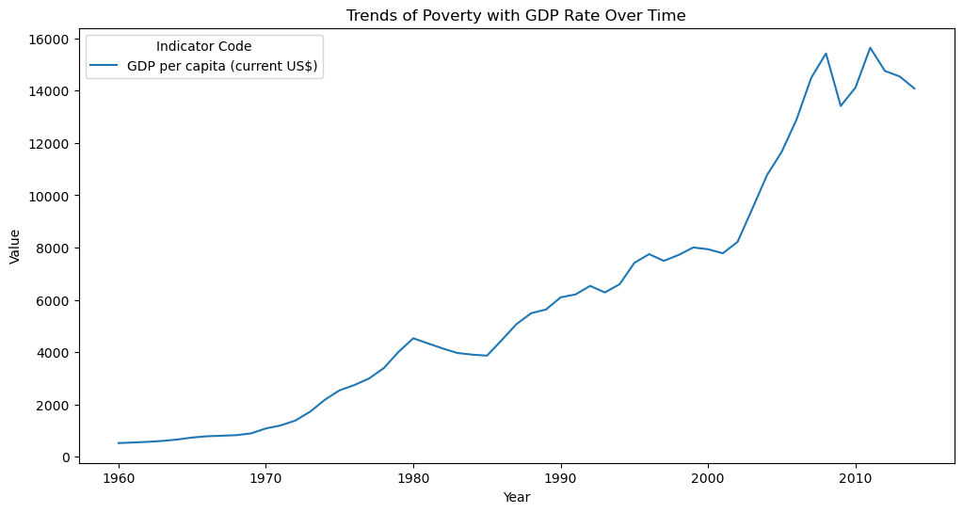

Slide 10
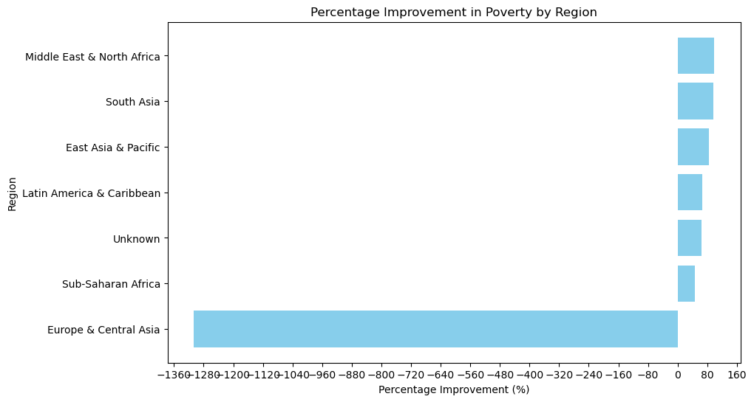

Slide 11
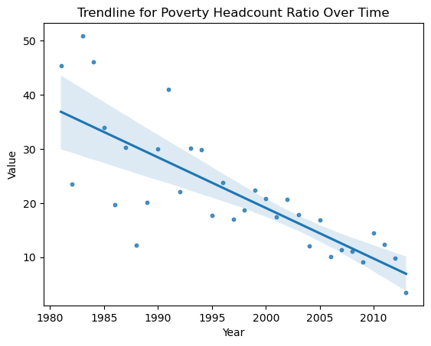

Slide 12
Data
Data Source:
World Bank Development Indicators (WDI) dataset (CSV format), covering over 1,600 indicators across multiple countries and years.
Preprocessing Steps:
Pivoting Data
Imputation
Feature Engineering

Slide 13
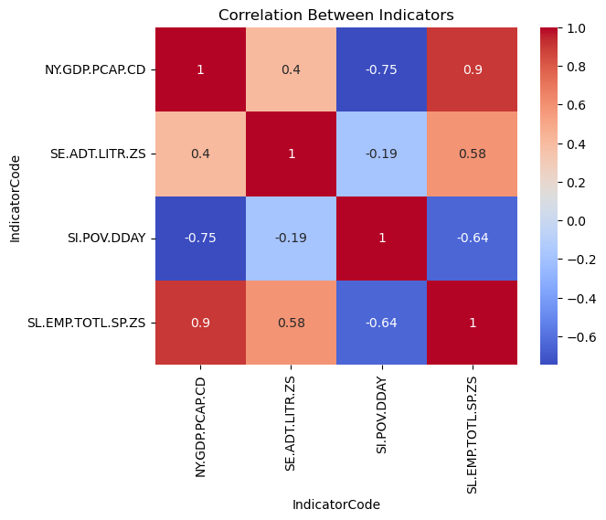

Slide 14
Indicator Code | Name | Value
SH.DYN.MORT | Mortality rate, under-5 (per 1,000 live births) | 0.80446
SP.DYN.IMRT.IN | Mortality rate, infant (per 1,000 live births) | 0.799712
SH.ANM.CHLD.ZS | Prevalence of anemia among children (% of children under 5) | 0.751971
SH.DYN.NMRT | Mortality rate, neonatal (per 1,000 live births) | 0.748466
SH.STA.MMRT | Maternal mortality ratio (modeled estimate, per 100,000 live births) | 0.747688
SP.DYN.TFRT.IN | Fertility rate, total (births per woman) | 0.745713
SP.DYN.CBRT.IN | Birth rate, crude (per 1,000 people) | 0.745276
SP.POP.DPND.YG | Age dependency ratio, young (% of working-age population) | 0.712707
SH.MMR.RISK.ZS | Lifetime risk of maternal death (%) | 0.711735
SE.PRM.ENRL.TC.ZS | Pupil-teacher ratio, primary | 0.709064
SP.POP.DPND | Age dependency ratio (% of working-age population) | 0.707188
SH.PRG.ANEM | Prevalence of anemia among pregnant women (%) | 0.700128
SE.PRM.PRSL.FE.ZS | Persistence to last grade of primary, female (% of cohort) | -0.706912
SE.SEC.CMPT.LO.FE.ZS | Lower secondary completion rate, female (% of relevant age group) | -0.708057
SE.SEC.TCHR.FE.ZS | Secondary education, teachers (% female) | -0.709631
SP.DYN.LE00.MA.IN | Life expectancy at birth, male (years) | -0.715417
SE.SEC.NENR.MA | School enrollment, secondary, male (% net) | -0.724865
SE.SEC.NENR | School enrollment, secondary (% net) | -0.744717
SE.SEC.NENR.FE | School enrollment, secondary, female (% net) | -0.755069
SH.H2O.SAFE.ZS | Improved water source (% of population with access) | -0.756944
SP.DYN.TO65.FE.ZS | Survival to age 65, female (% of cohort) | -0.761994
SH.STA.ACSN.UR | Improved sanitation facilities, urban (% of urban population with access) | -0.764675
SP.DYN.LE00.IN | Life expectancy at birth, total (years) | -0.767949
SE.SEC.ENRR | School enrollment, secondary (% gross) | -0.77139
SH.STA.ACSN | Improved sanitation facilities (% of population with access) | -0.780959
SP.DYN.LE00.FE.IN | Life expectancy at birth, female (years) | -0.796204

Slide 15
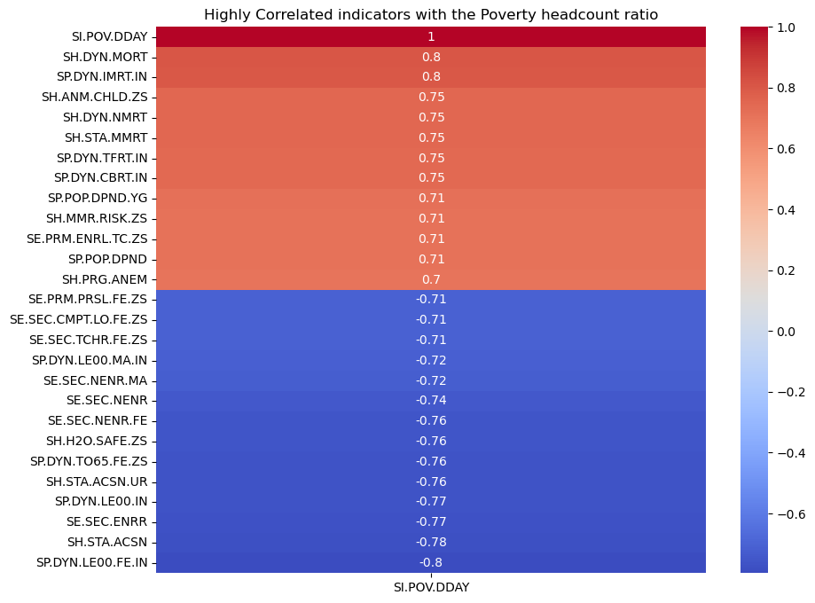

Slide 16
Model

Slide 17
Model Selection and Training/Testing
Models Employed:
Decision Tree: For initial analysis and feature importance evaluation.
Random Forest: To enhance accuracy and reduce overfitting.
Gradient Boosting: For fine-tuning predictions by combining weak learners.
Training Process:
Data is split into training and testing sets (using a test size of 20% and a fixed random state for reproducibility).
Cross-validation and hyperparameter tuning (via GridSearchCV) ensure optimal performance.

Slide 18
Result

Slide 19
Evaluation Results
Model Performance:
Accuracy metrics for each model are logged and compared.
The best-performing model is identified and detailed (with accuracy scores and classification reports available).
Visual Aids:
Bar charts of model accuracy.
Feature importance visualizations and scatter plots generated within the app.

Slide 20
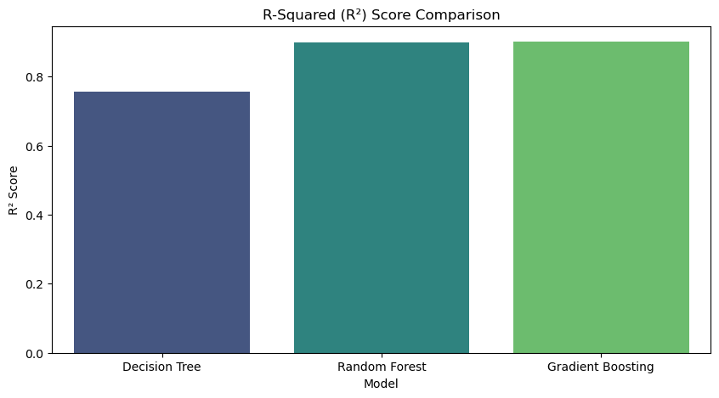

Slide 21
Model | MAE (↓ Better) | MSE (↓ Better) | R² (↑ Better)
Decision Tree | 6.35 | 116.94 | 0.756
Random Forest | 4.36 | 48.81 | 0.898
Gradient Boosting | 4.38 | 47.43 | 0.901

Slide 22
Deployment

Slide 23
Conclusion and Futurework
Conclusion:
Successfully developed an end-to-end solution that predicts poverty levels using socioeconomic data from the World Bank.
Future Work:
Advanced Modeling: Explore deep learning approaches and ensemble methods to boost prediction accuracy.
Deployment Expansion: Integrate the application with a web-based API for real-time data updates and broader accessibility.
Collaborating with NGOs: collaborate with NGOs to validate the predictions and use them for on-the-ground interventions.

Slide 24


Thank you!

